Slide 1
SAS PROGRAMMING STRUCTURE

Slide 2
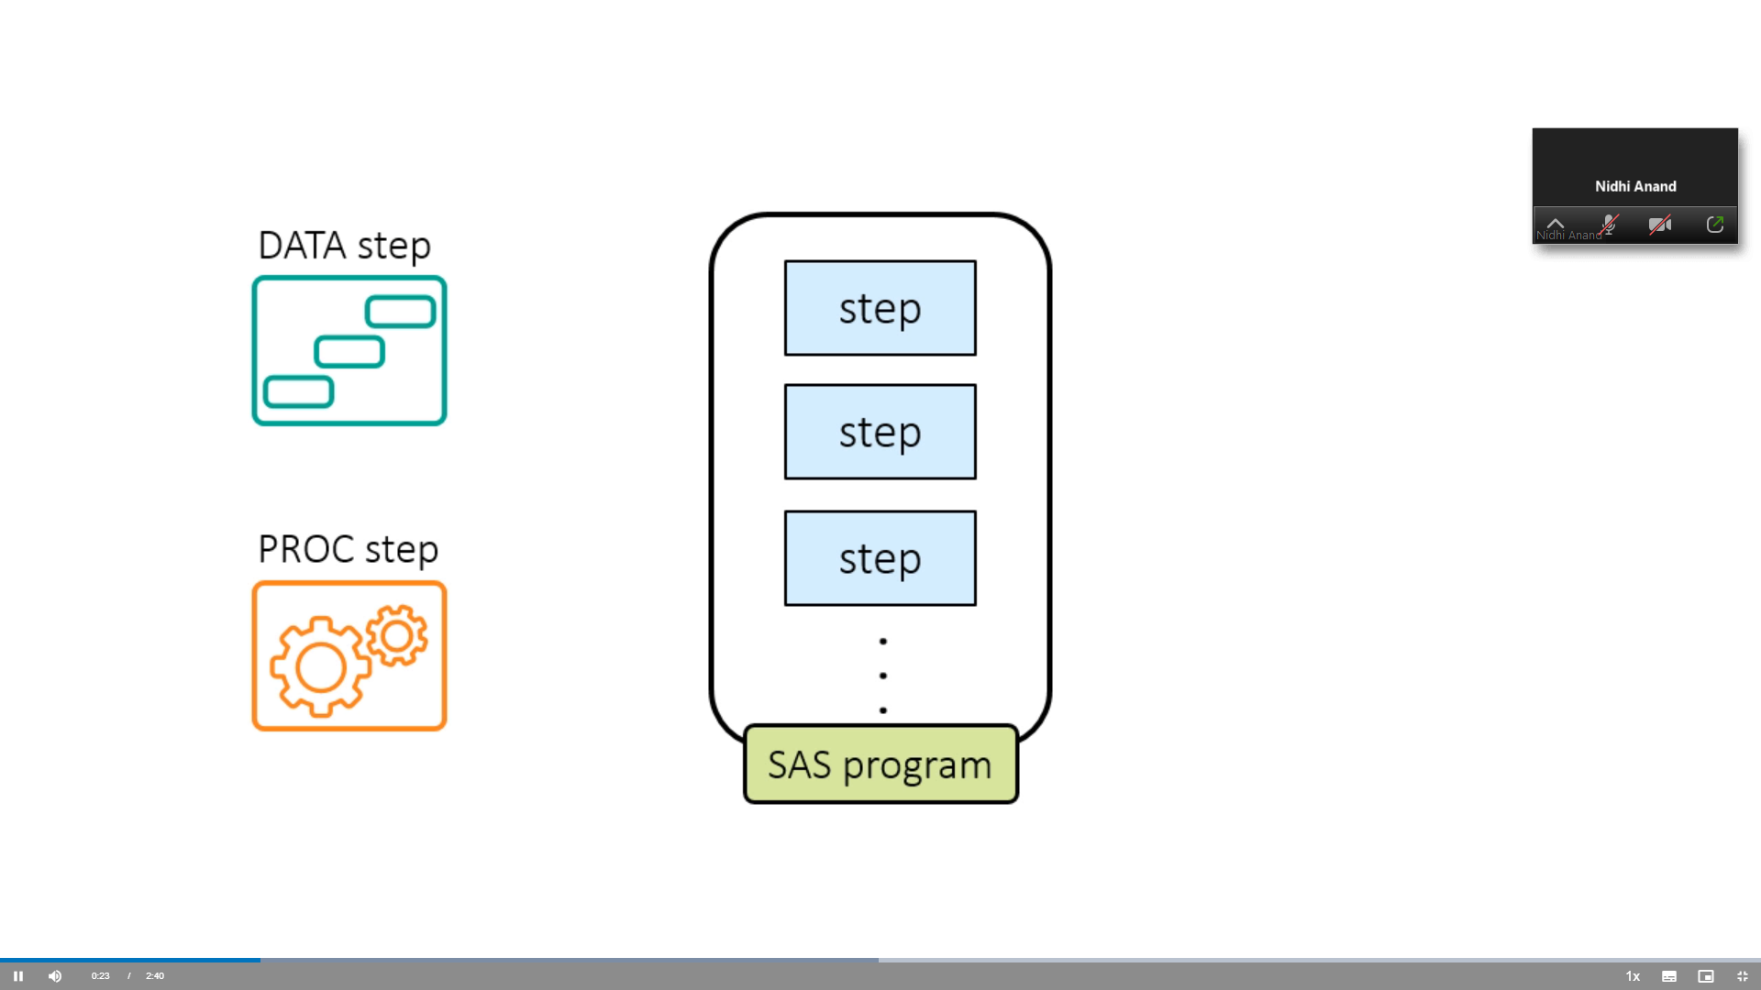

Slide 3
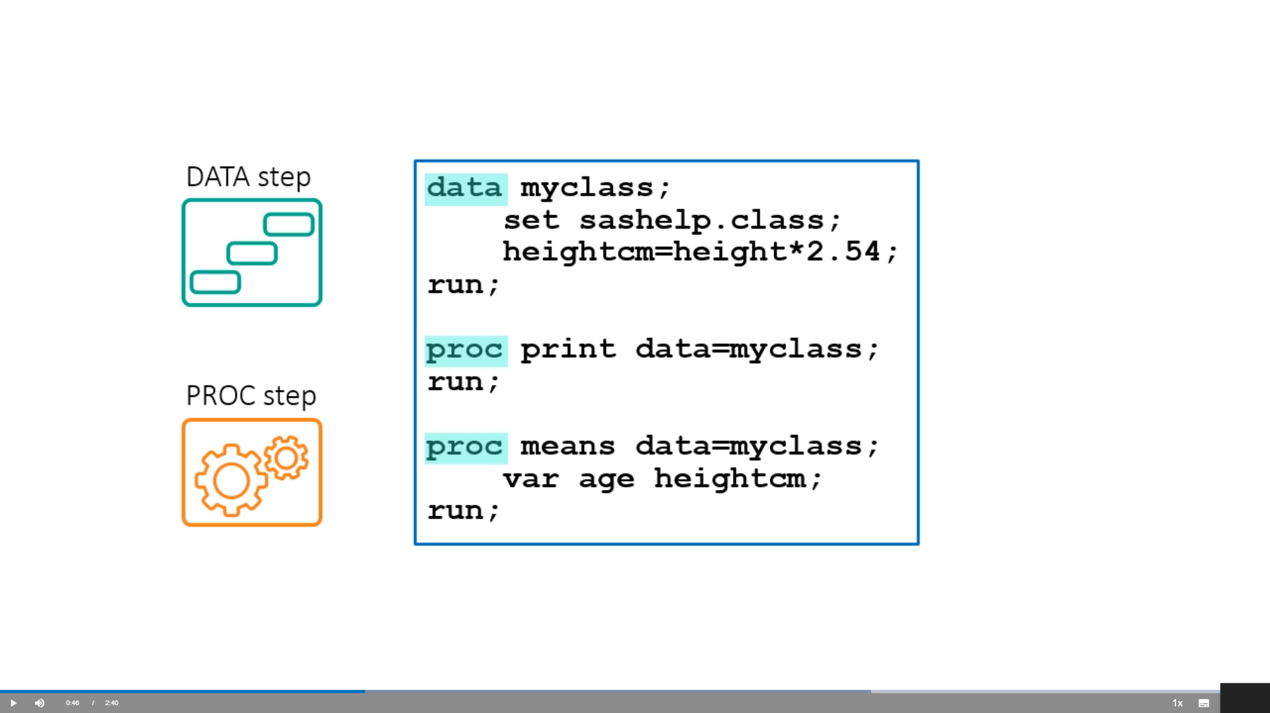

Slide 4
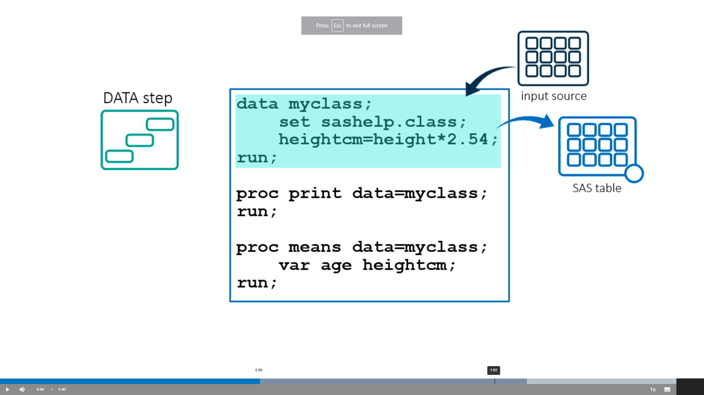

Slide 5
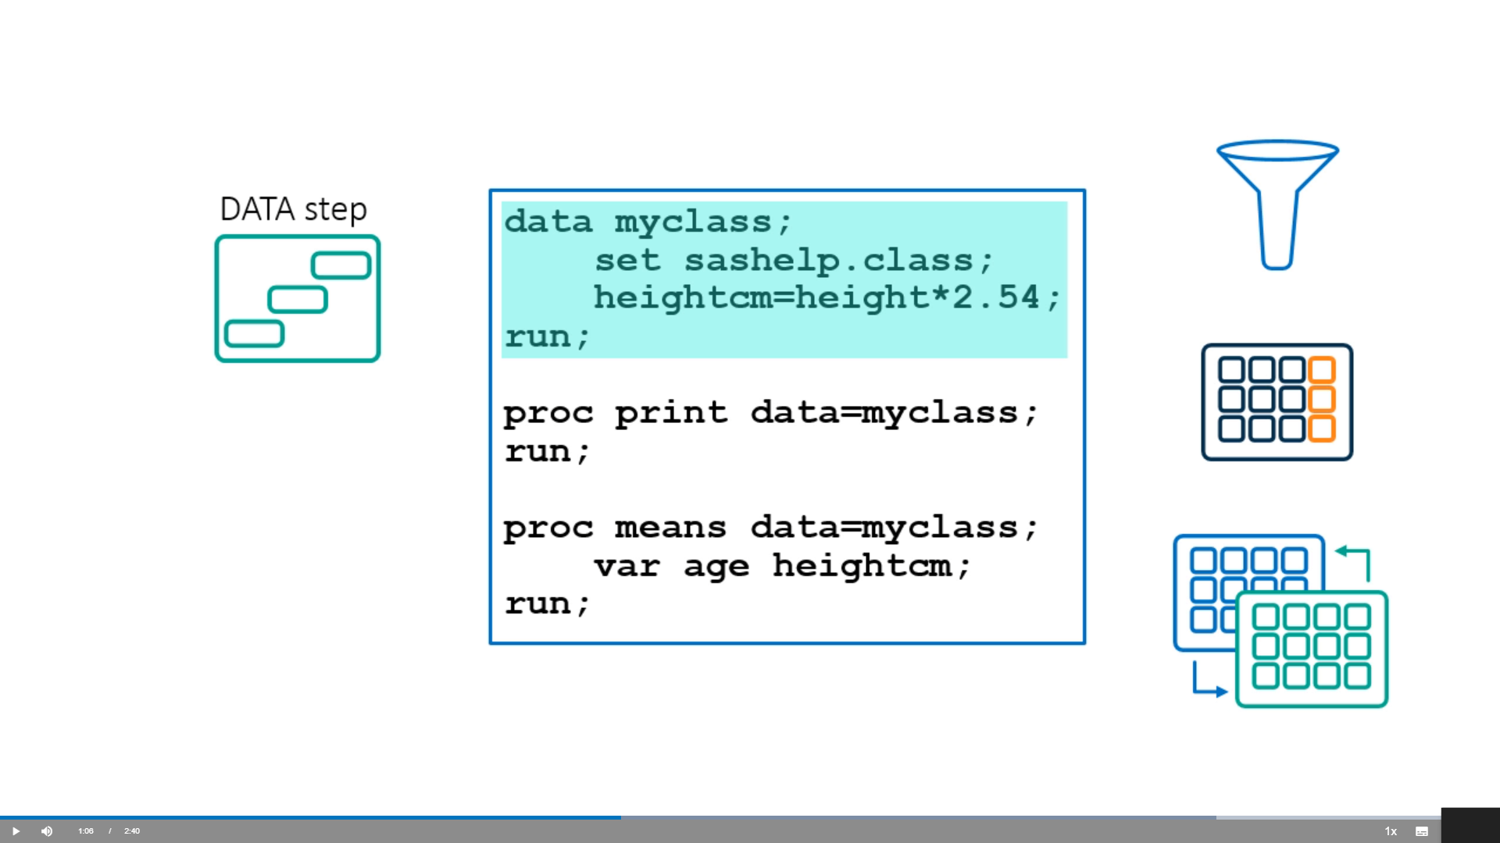

Slide 6
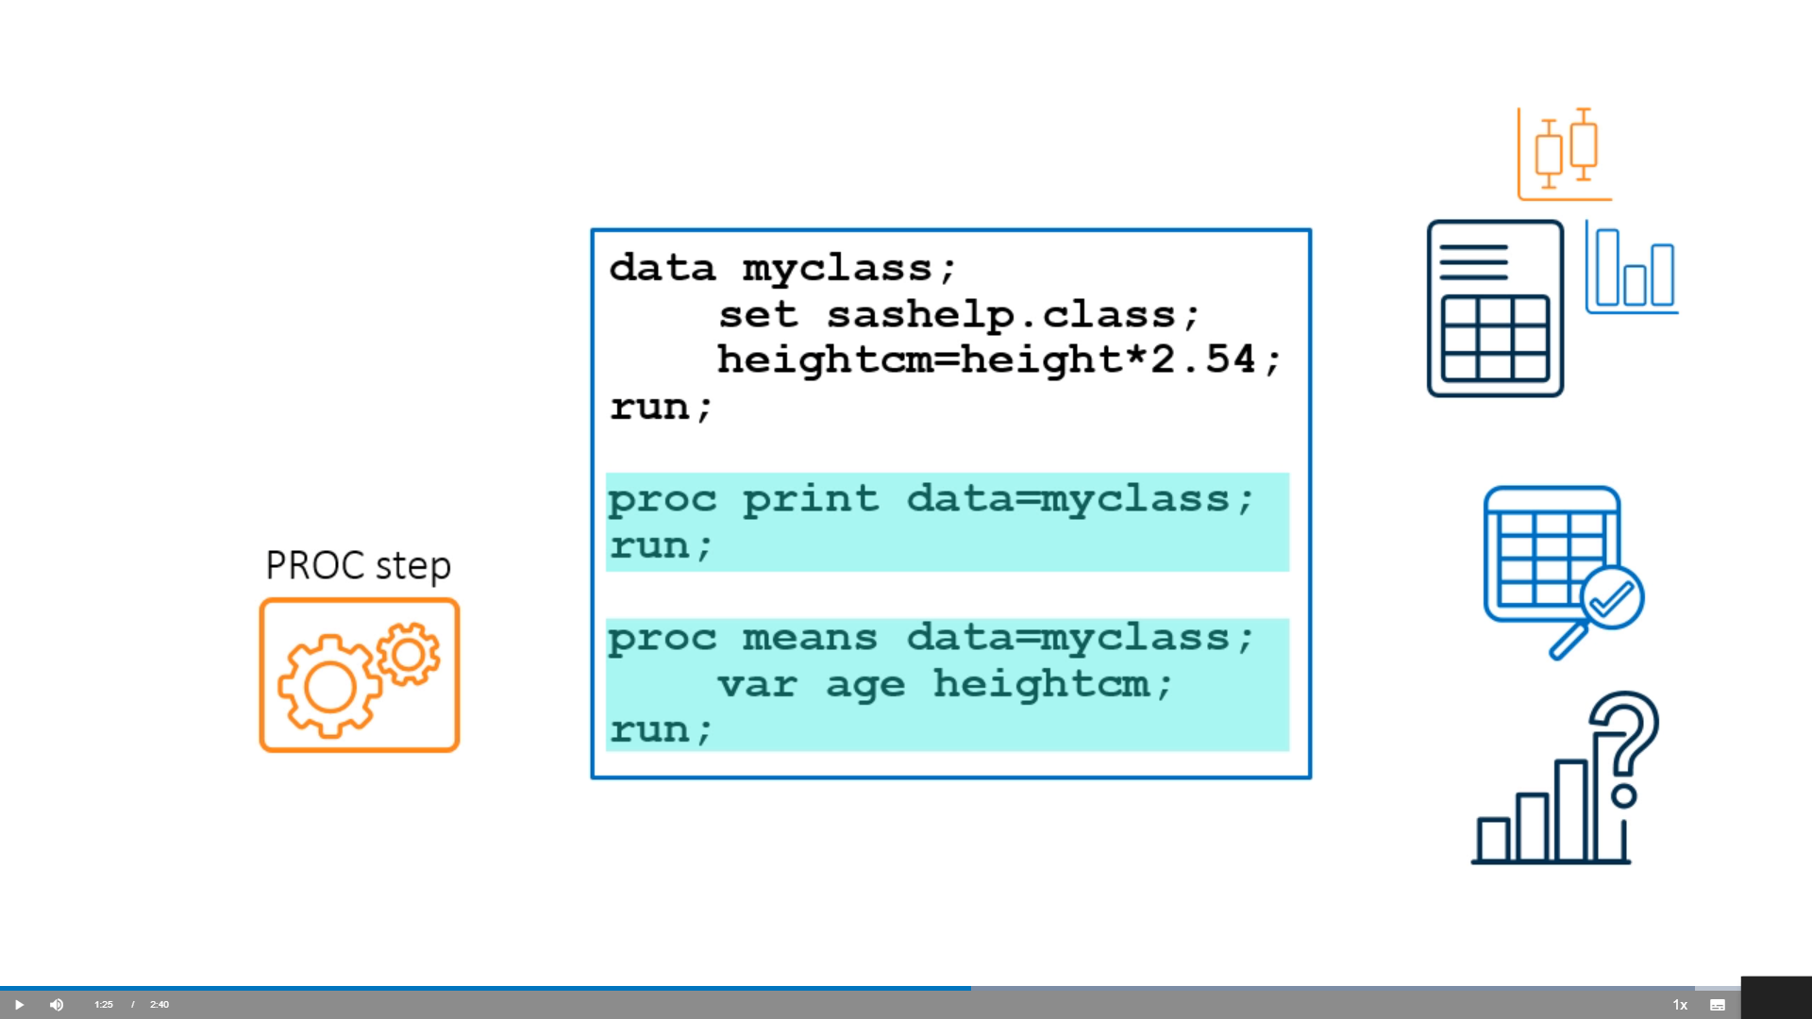

Slide 7
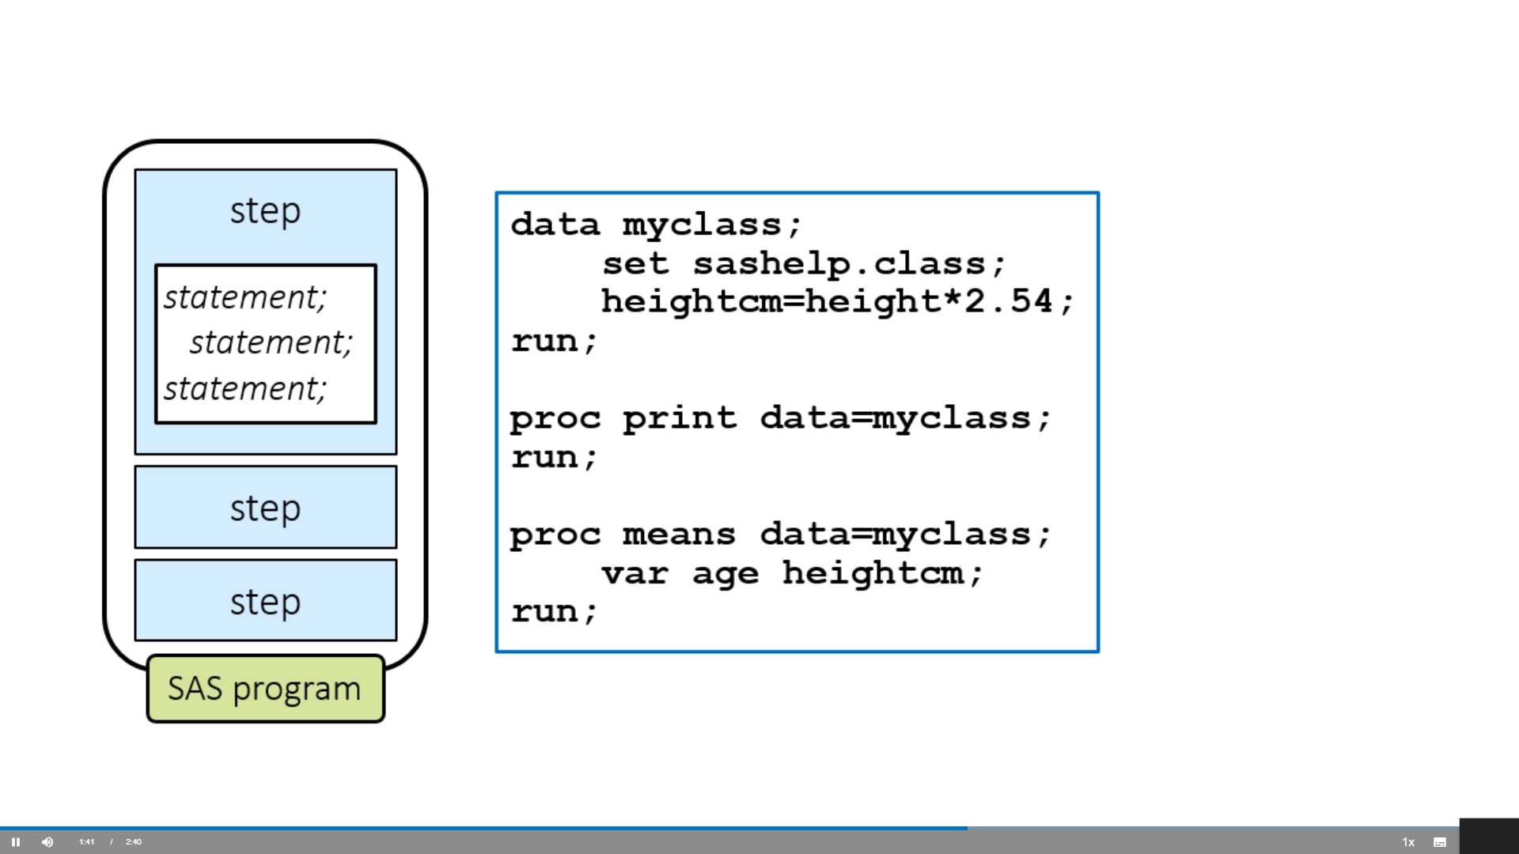

Slide 8
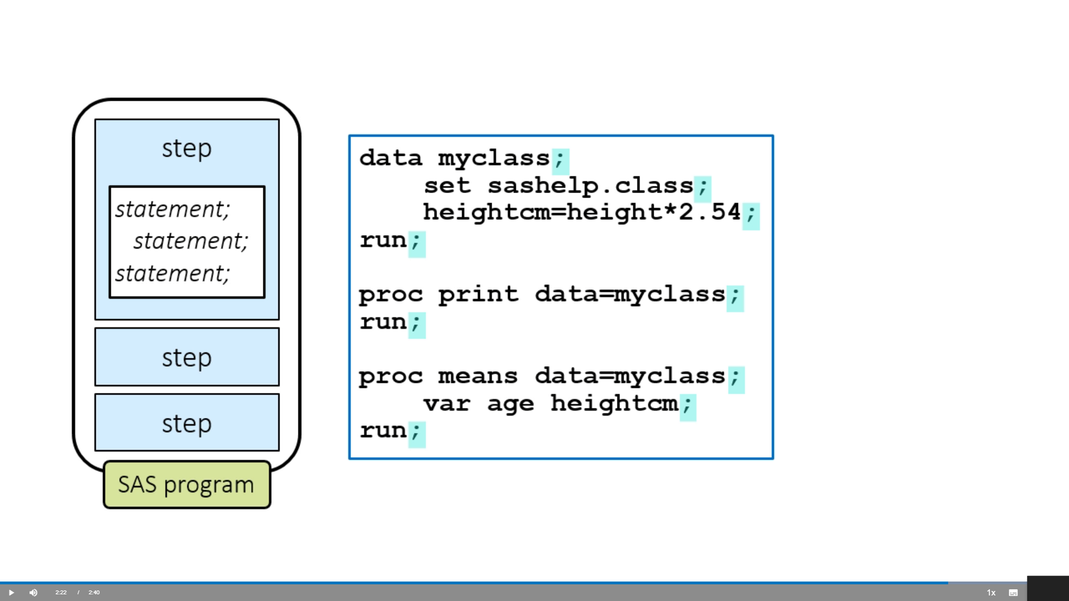

Slide 9
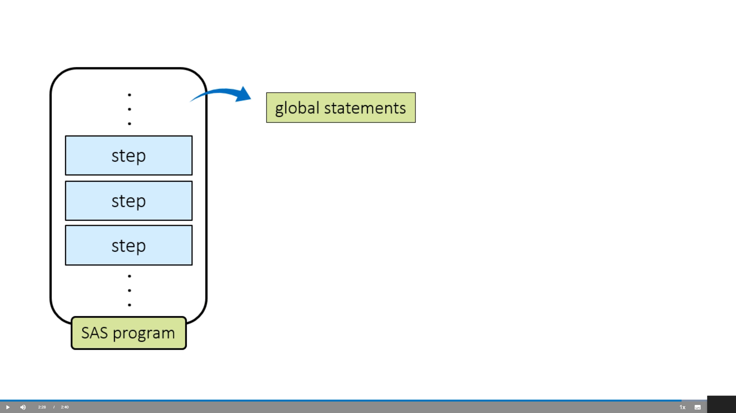

Slide 10
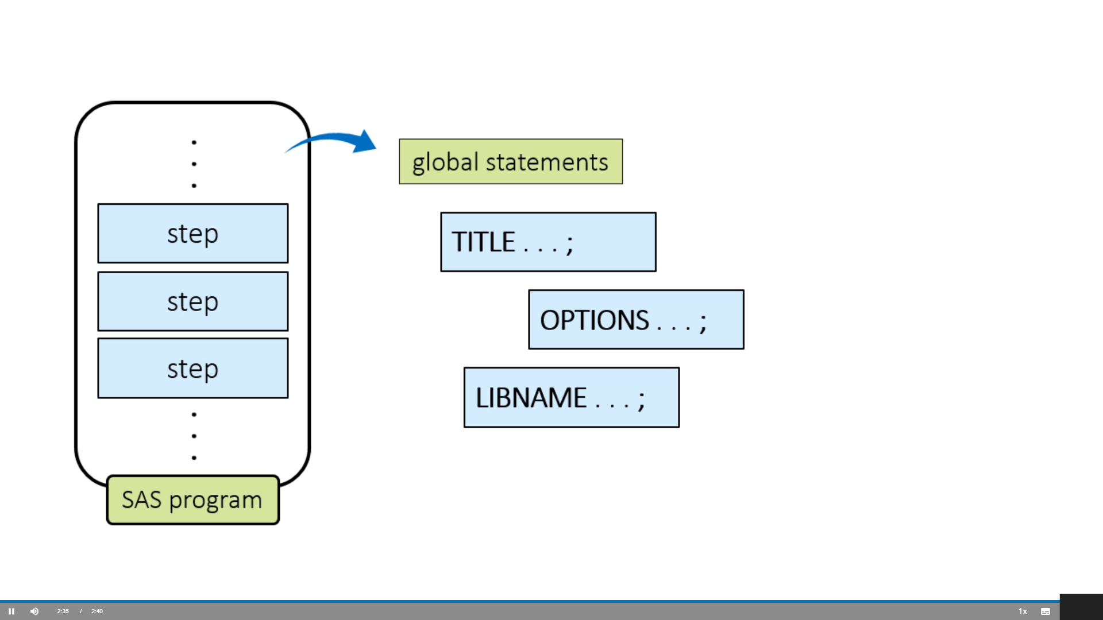

Slide 11
Finding and Resolving Syntax Errors
Finding and Resolving Syntax Errors
Current Time 0:24
/
Duration 4:15

Slide 12
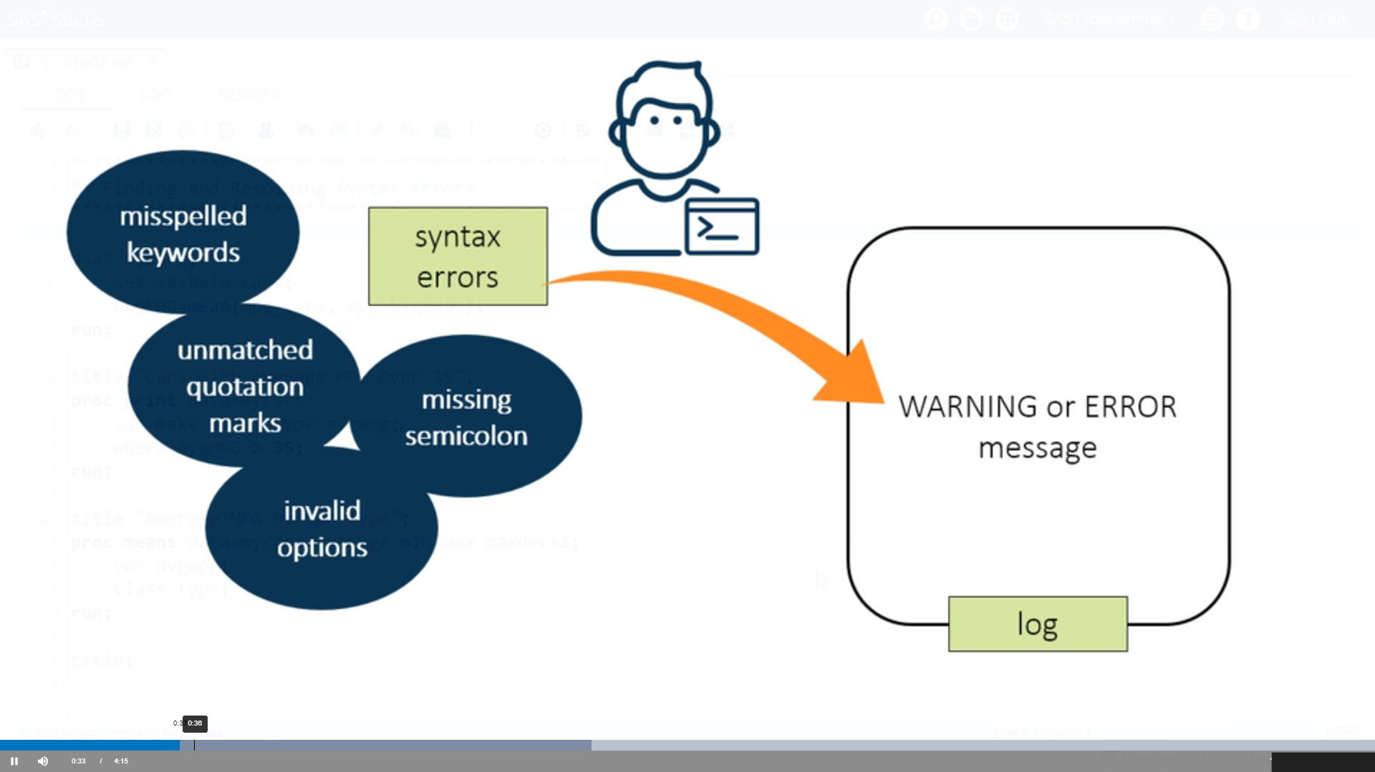

Slide 13
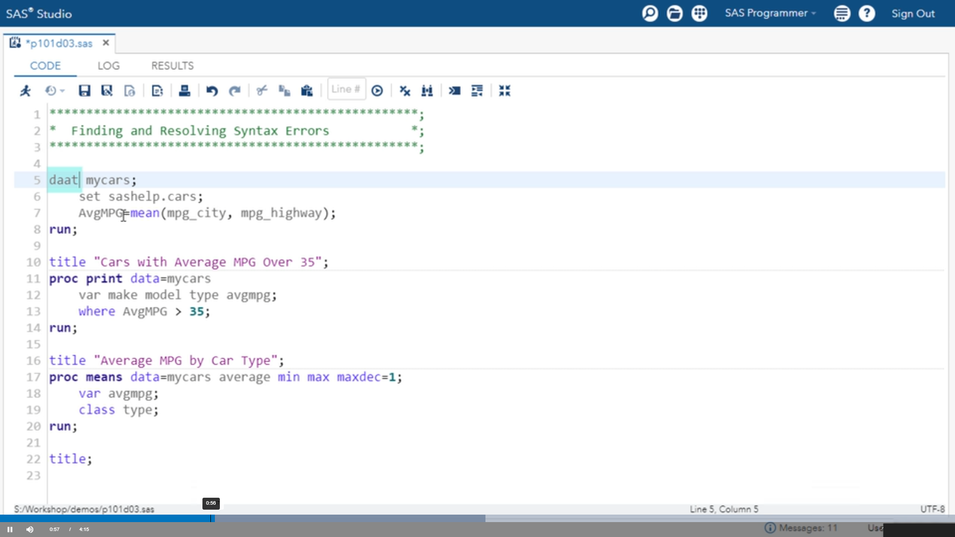

Slide 14
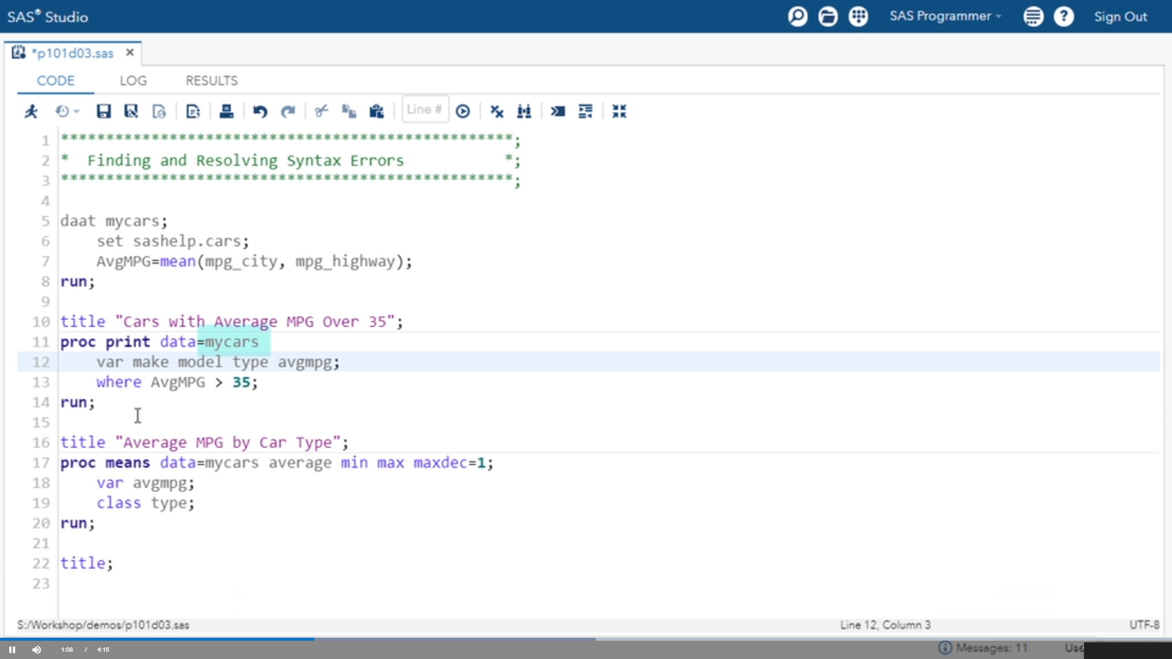

Slide 15
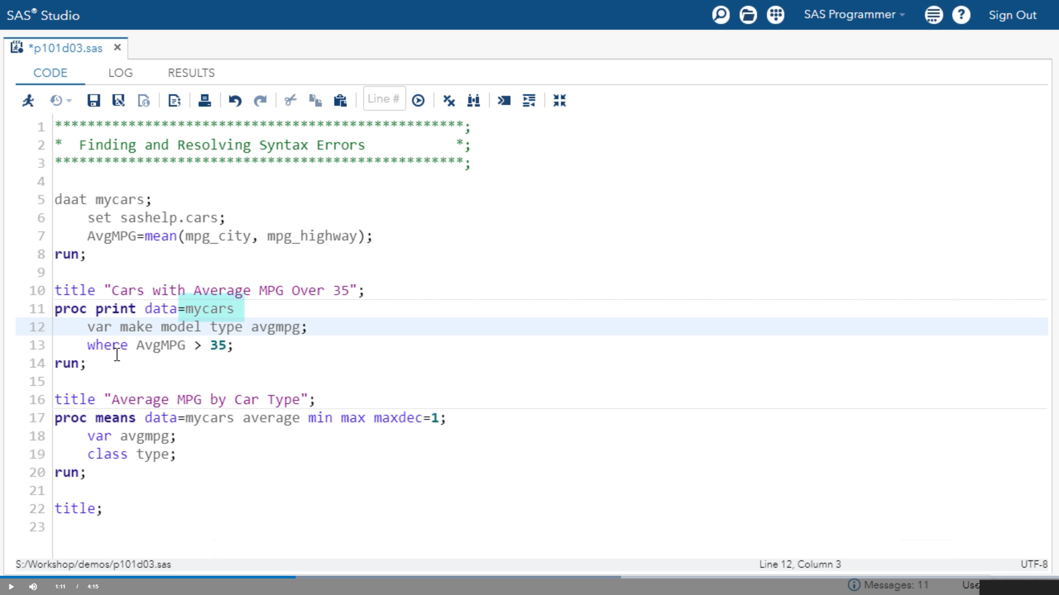

Slide 16
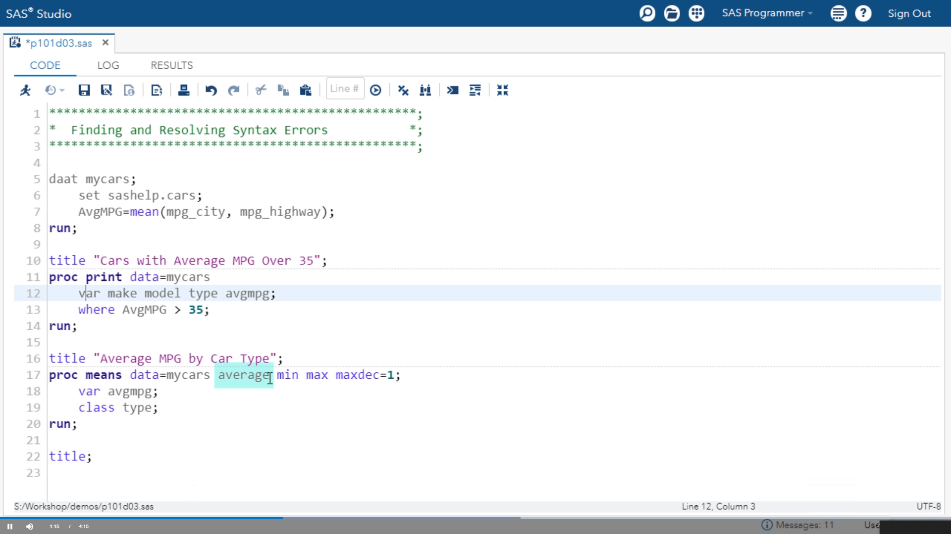

Slide 17
Types of Data

Slide 18
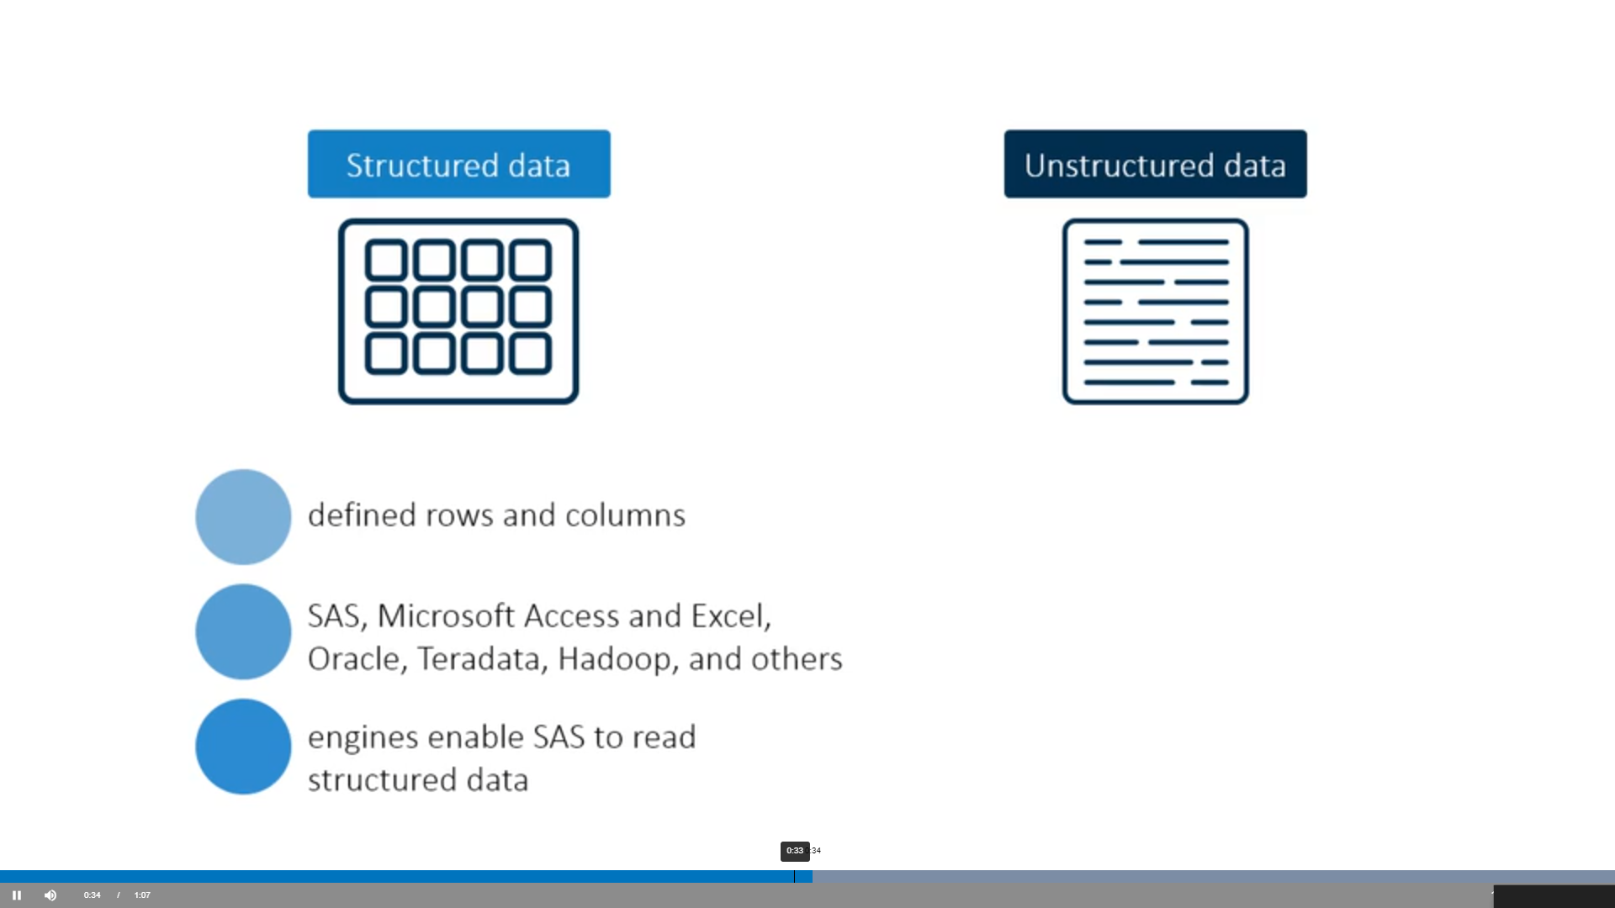

Slide 19
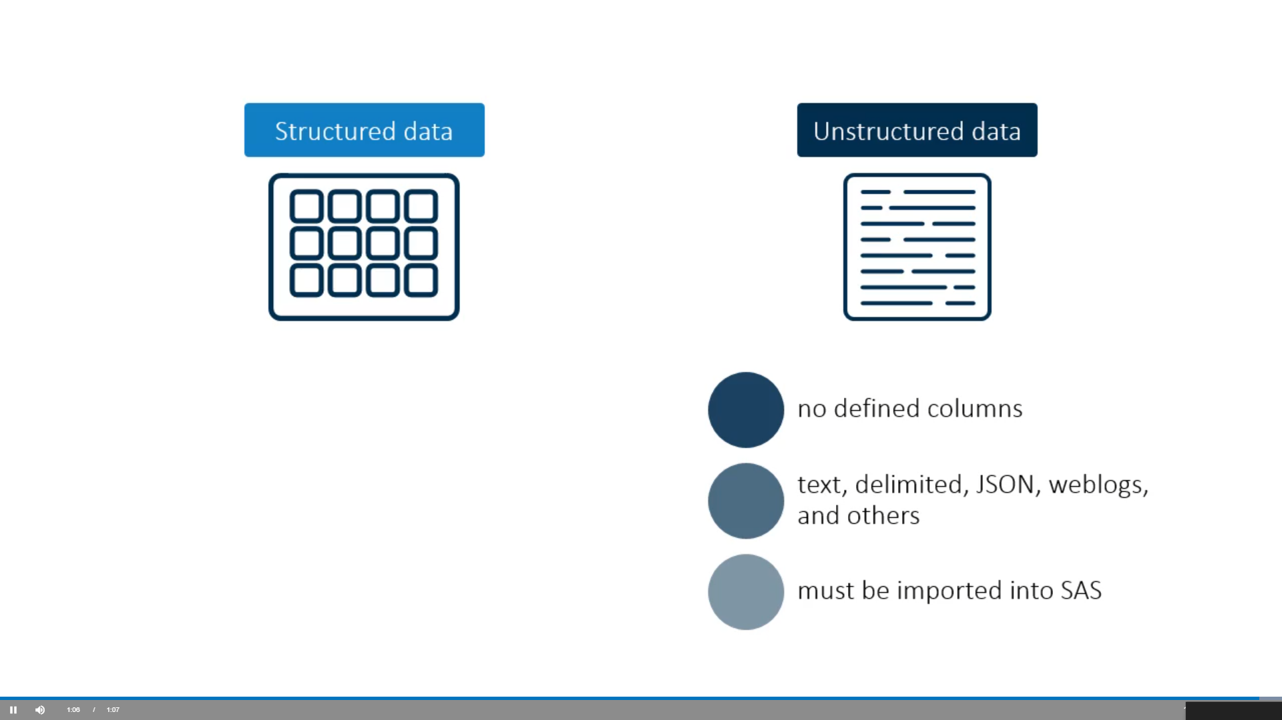

Slide 20
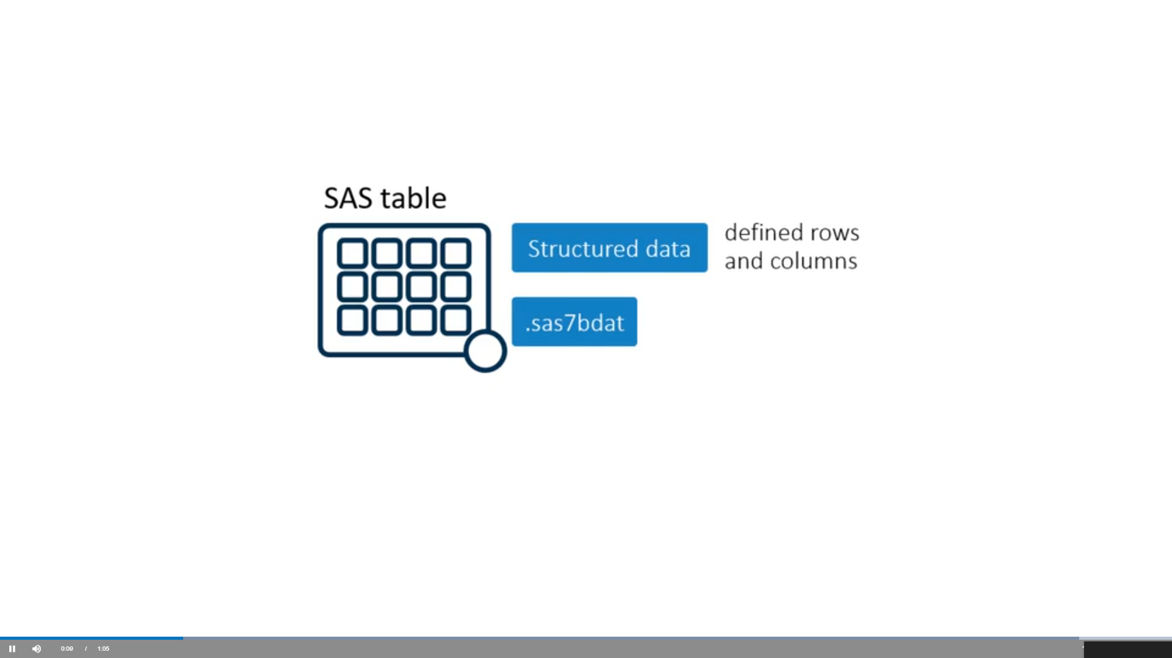

Slide 21
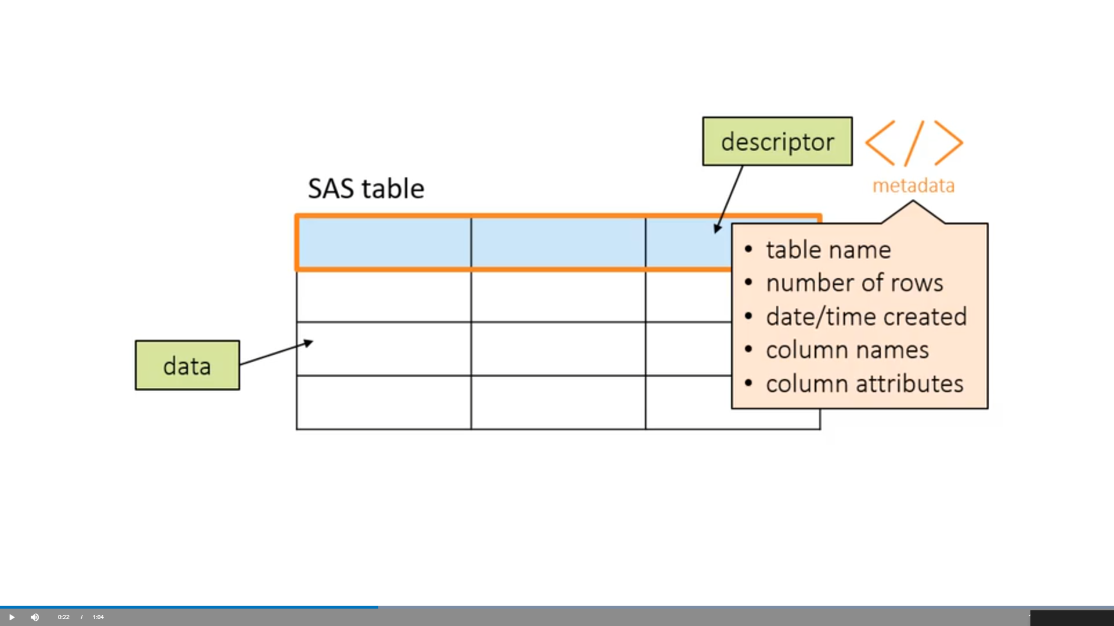

Slide 22
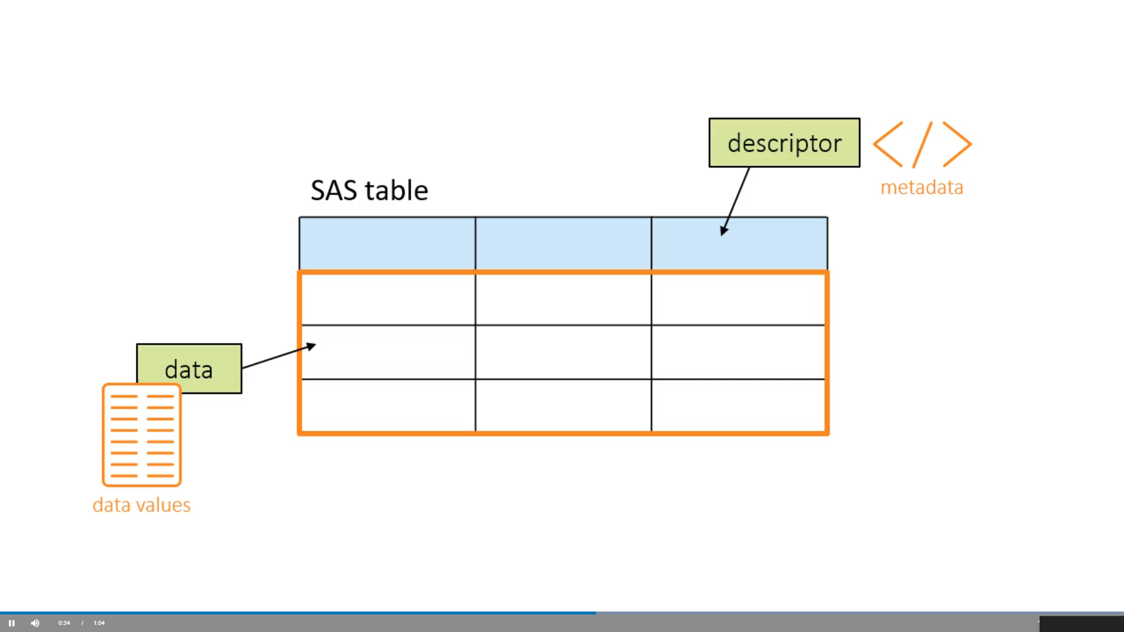

Slide 23
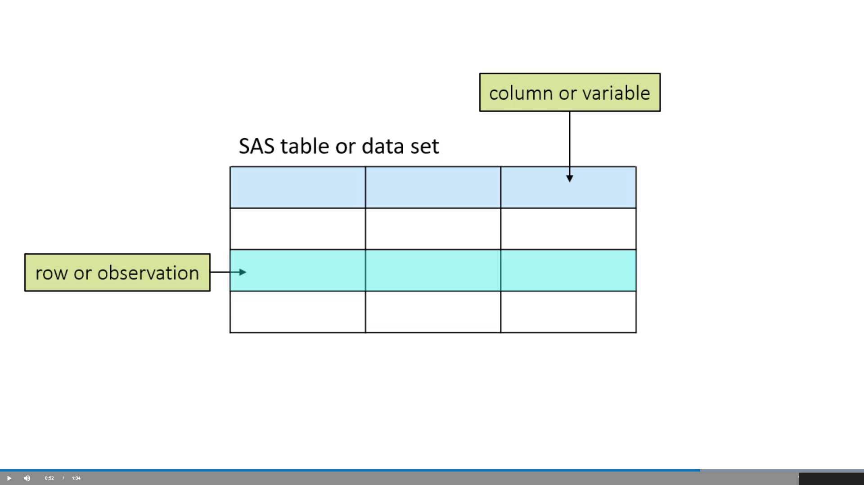

Slide 24
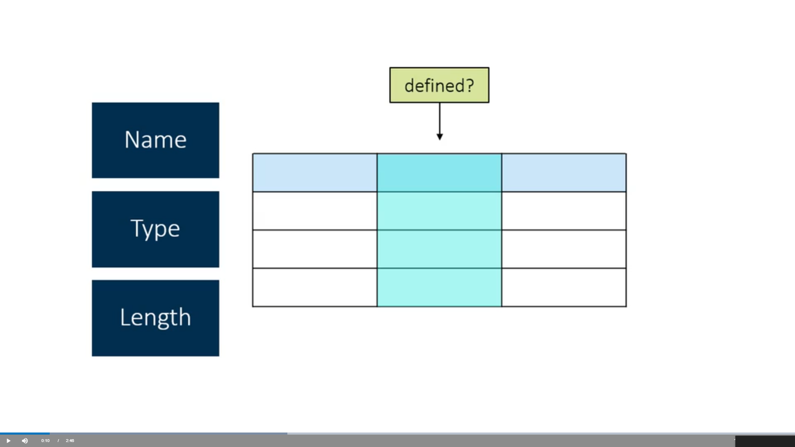

Slide 25
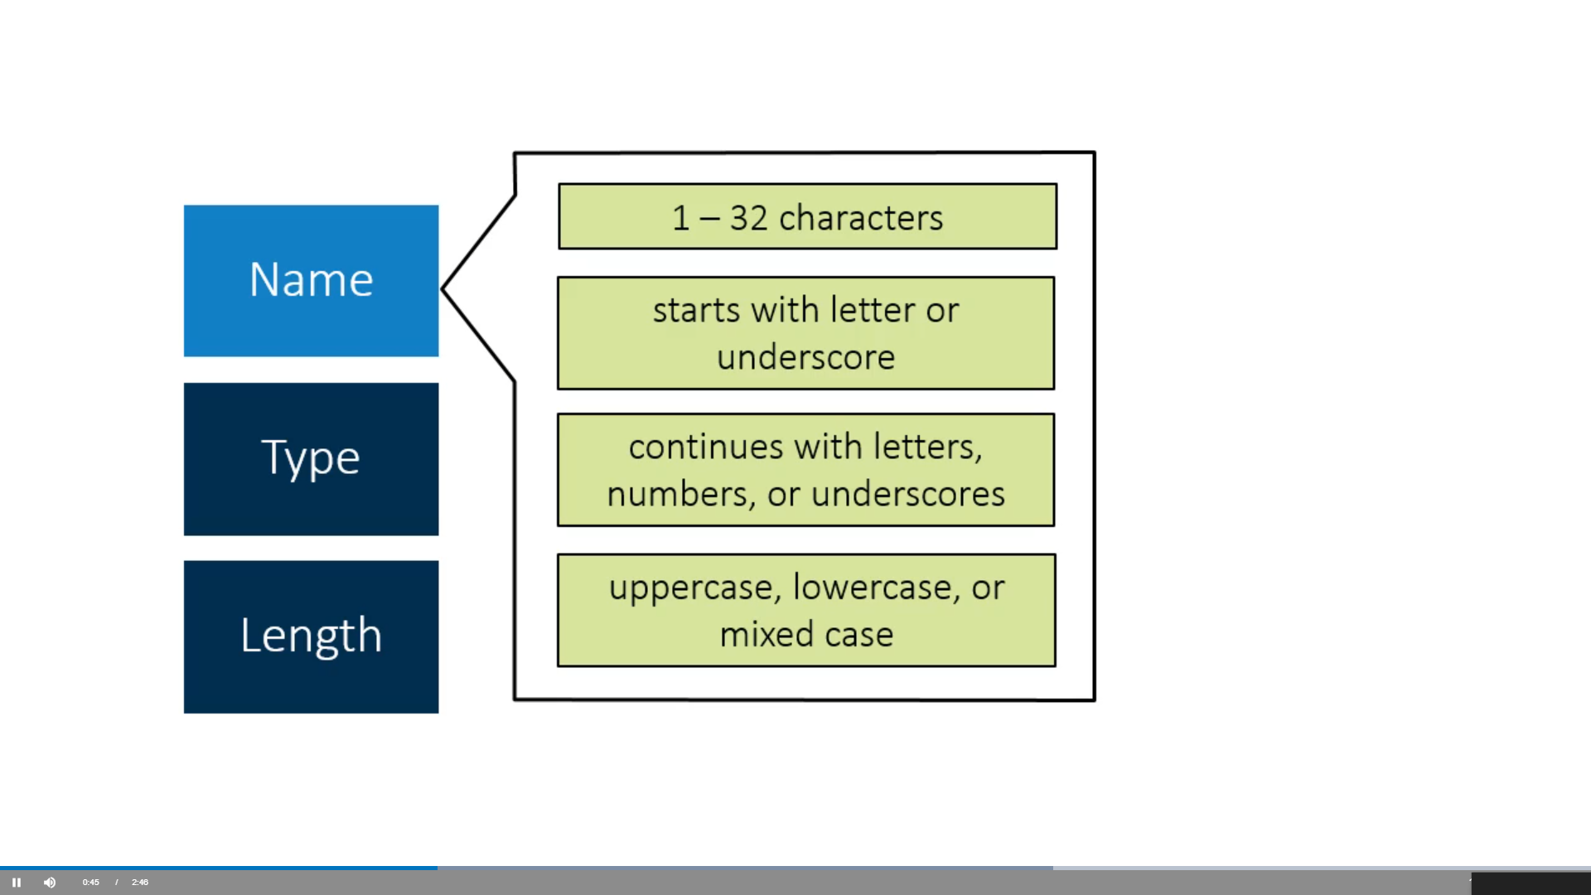
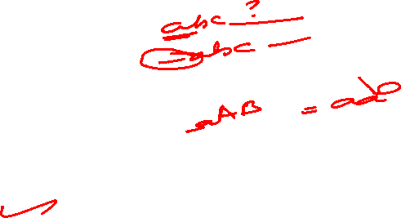

Slide 26
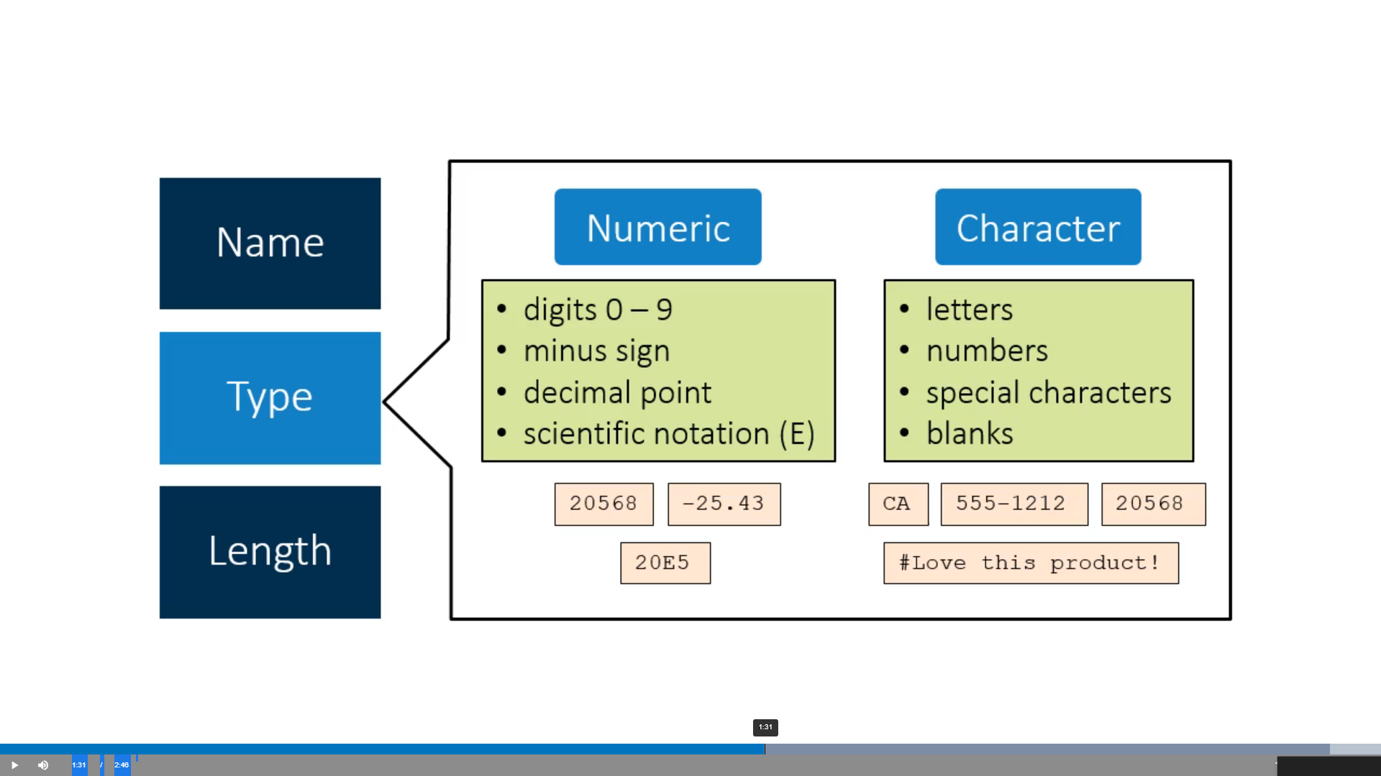

Slide 27
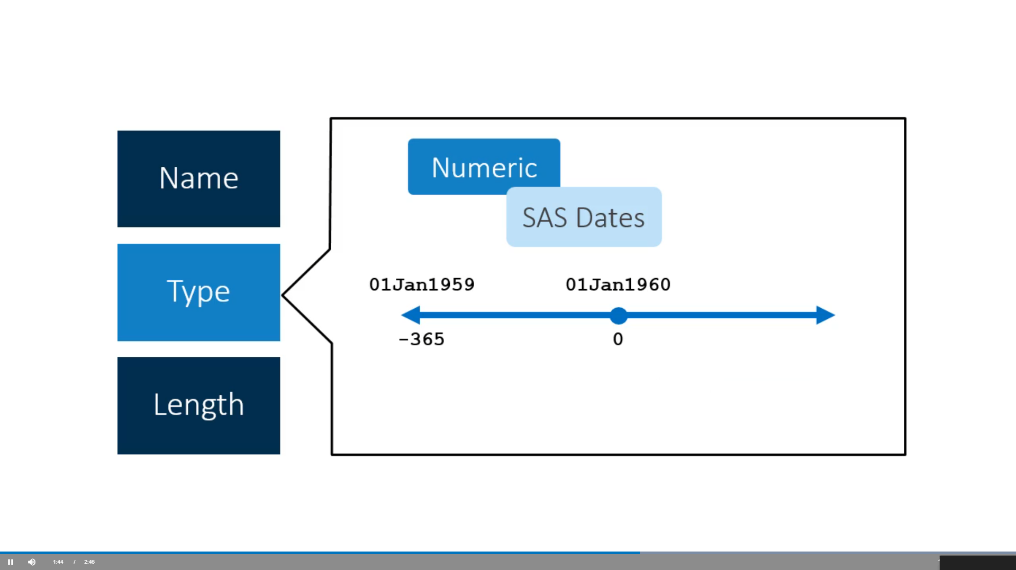

Slide 28
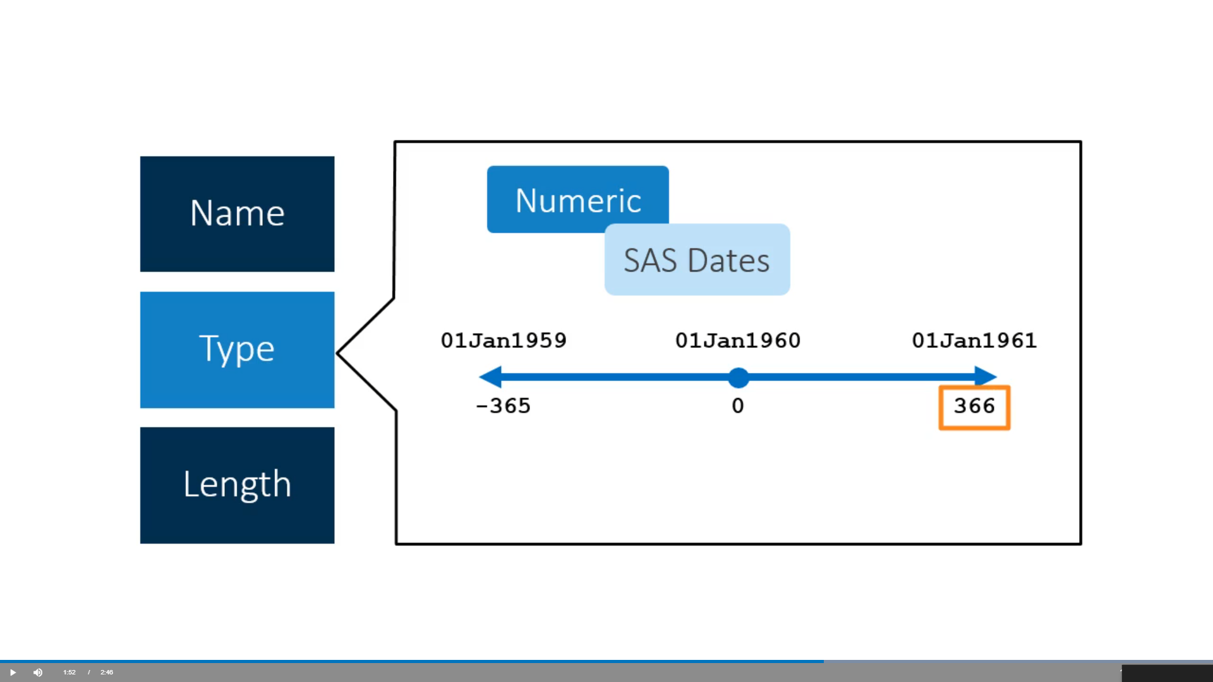

Slide 29
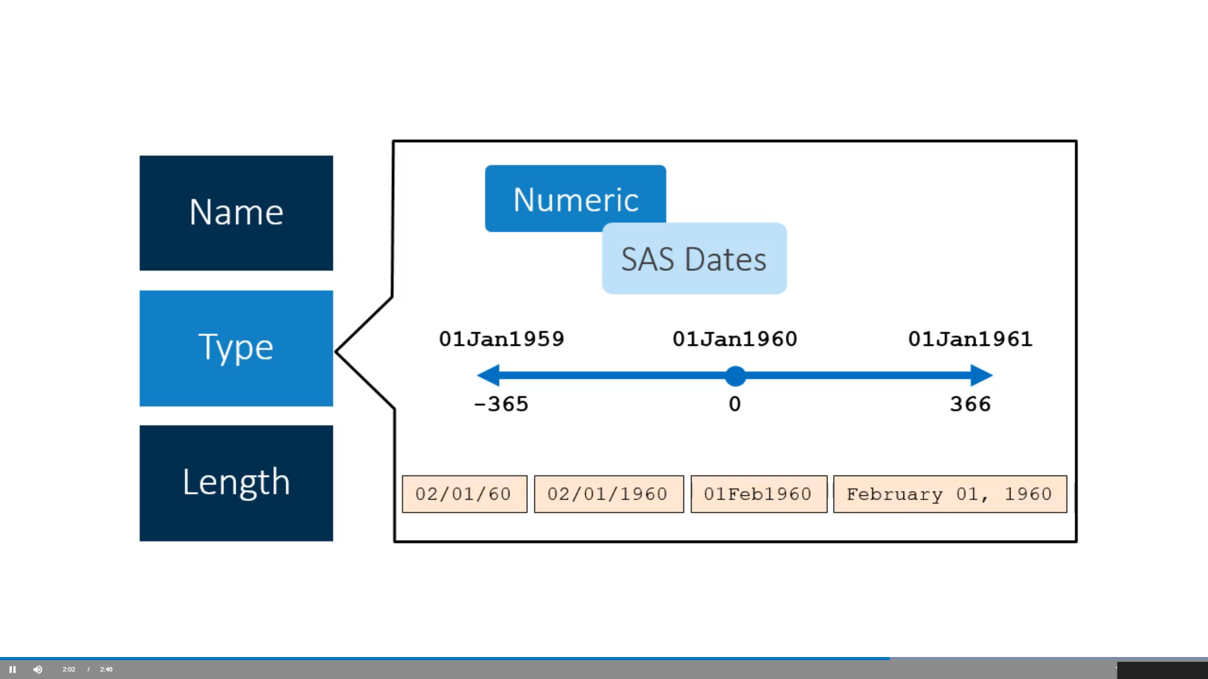

Slide 30
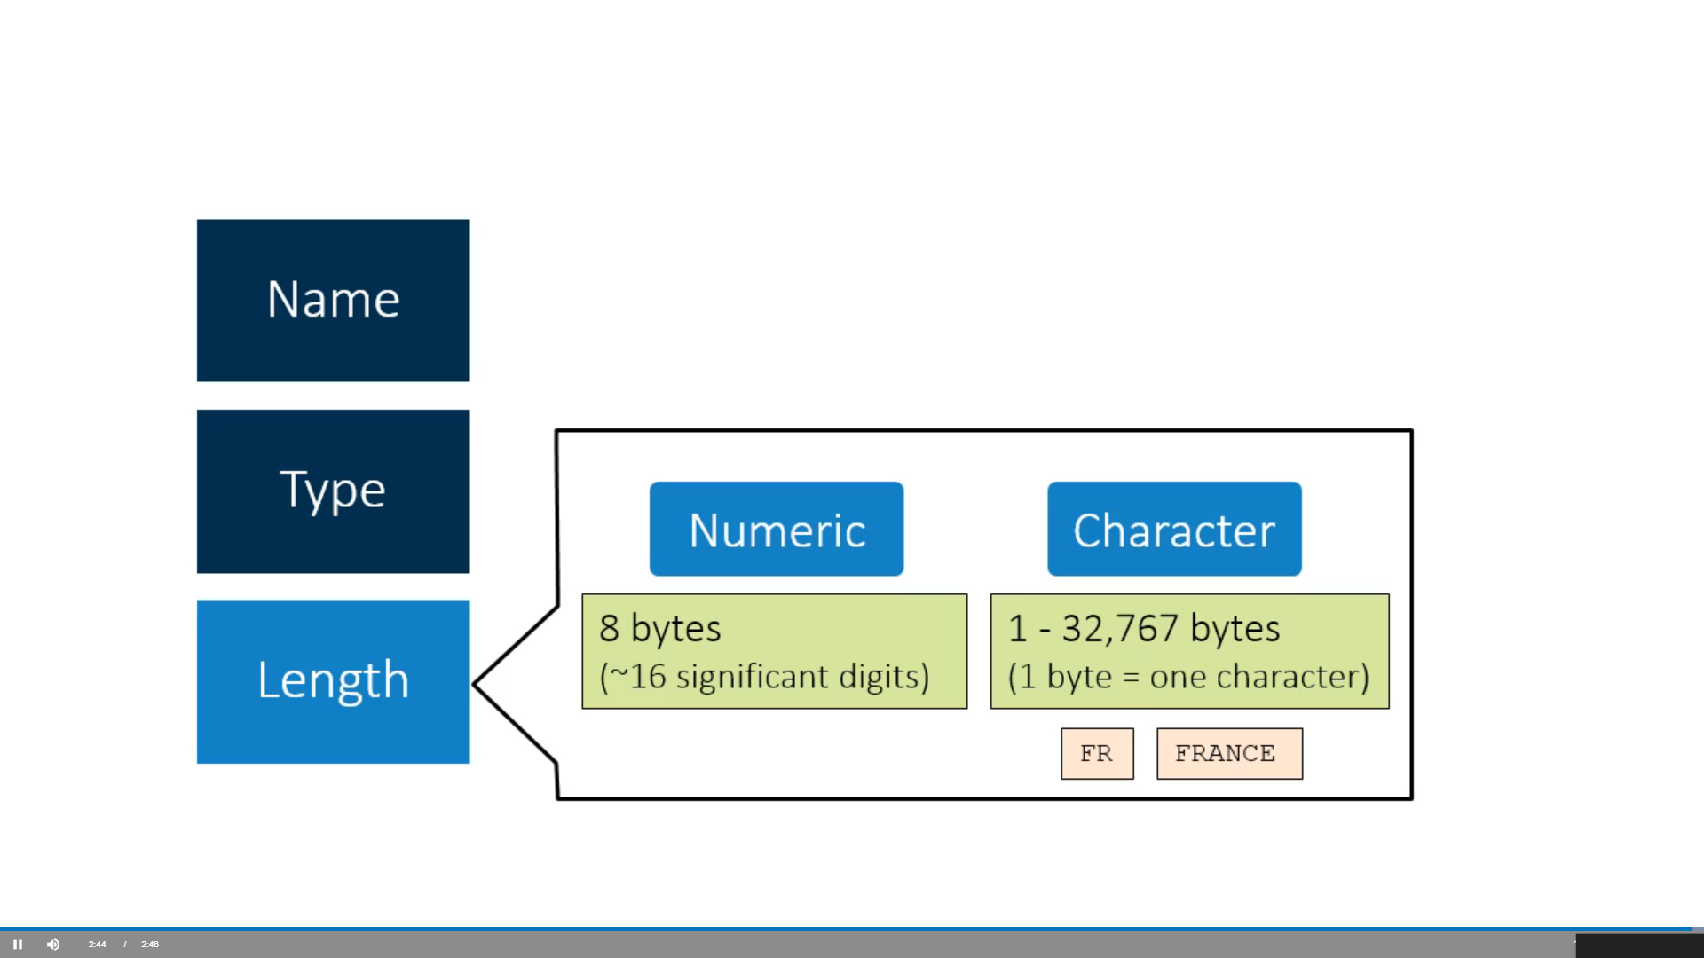

Slide 31
Variable Properties
SAS Variable has four important properties, name, length, format, and label.
Name
Length
Format
Label

Slide 32
STRING
Strings in SAS are those values which are enclosed in a pair of single quotes.
In SAS, the string variable is declared by adding a space and the $ sign at the end of the variable declaration.
There are several powerful functions to analyze and manipulate strings in SAS.
DATA string_example;
String1 = 'Hello';
RUN;
PROC print data = string_example;
RUN;

Slide 33
DATA string_example;
String1 = 'Hello';
RUN;
PROC print data = string_example;
RUN;

Slide 34
SUBSTRING Function
SUBSTRN statement is used to extract a substring by using the start and end positions.
Syntax:
SUBSTRN ('string value' ,p1,p2)
Where,
SUBSTRN: It is a statement used to extract characters from the string.
String value: It is the value of the string variable.
p1: It is the start position of extraction.
p2 It is the end position of extraction.

Slide 35
Listing Table and Column Attributes

Slide 36
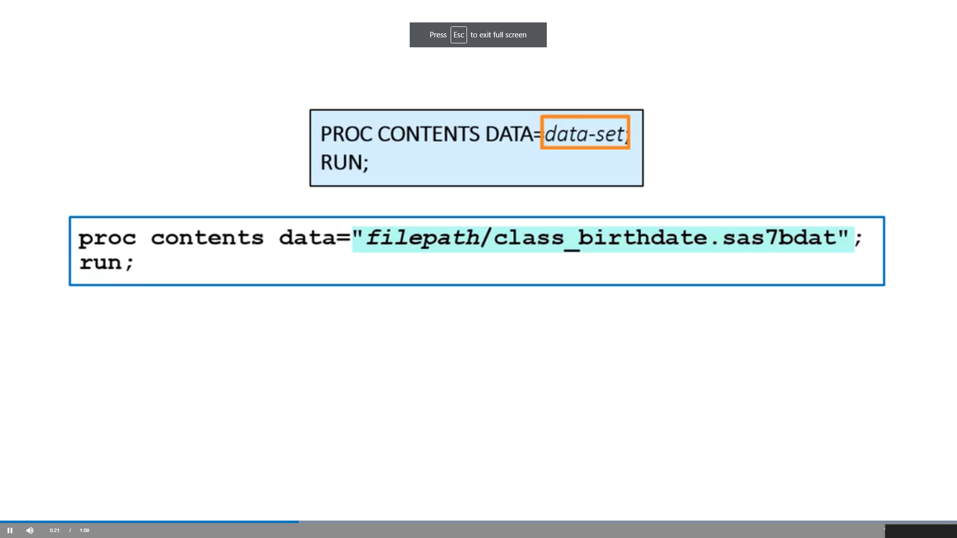

Slide 37
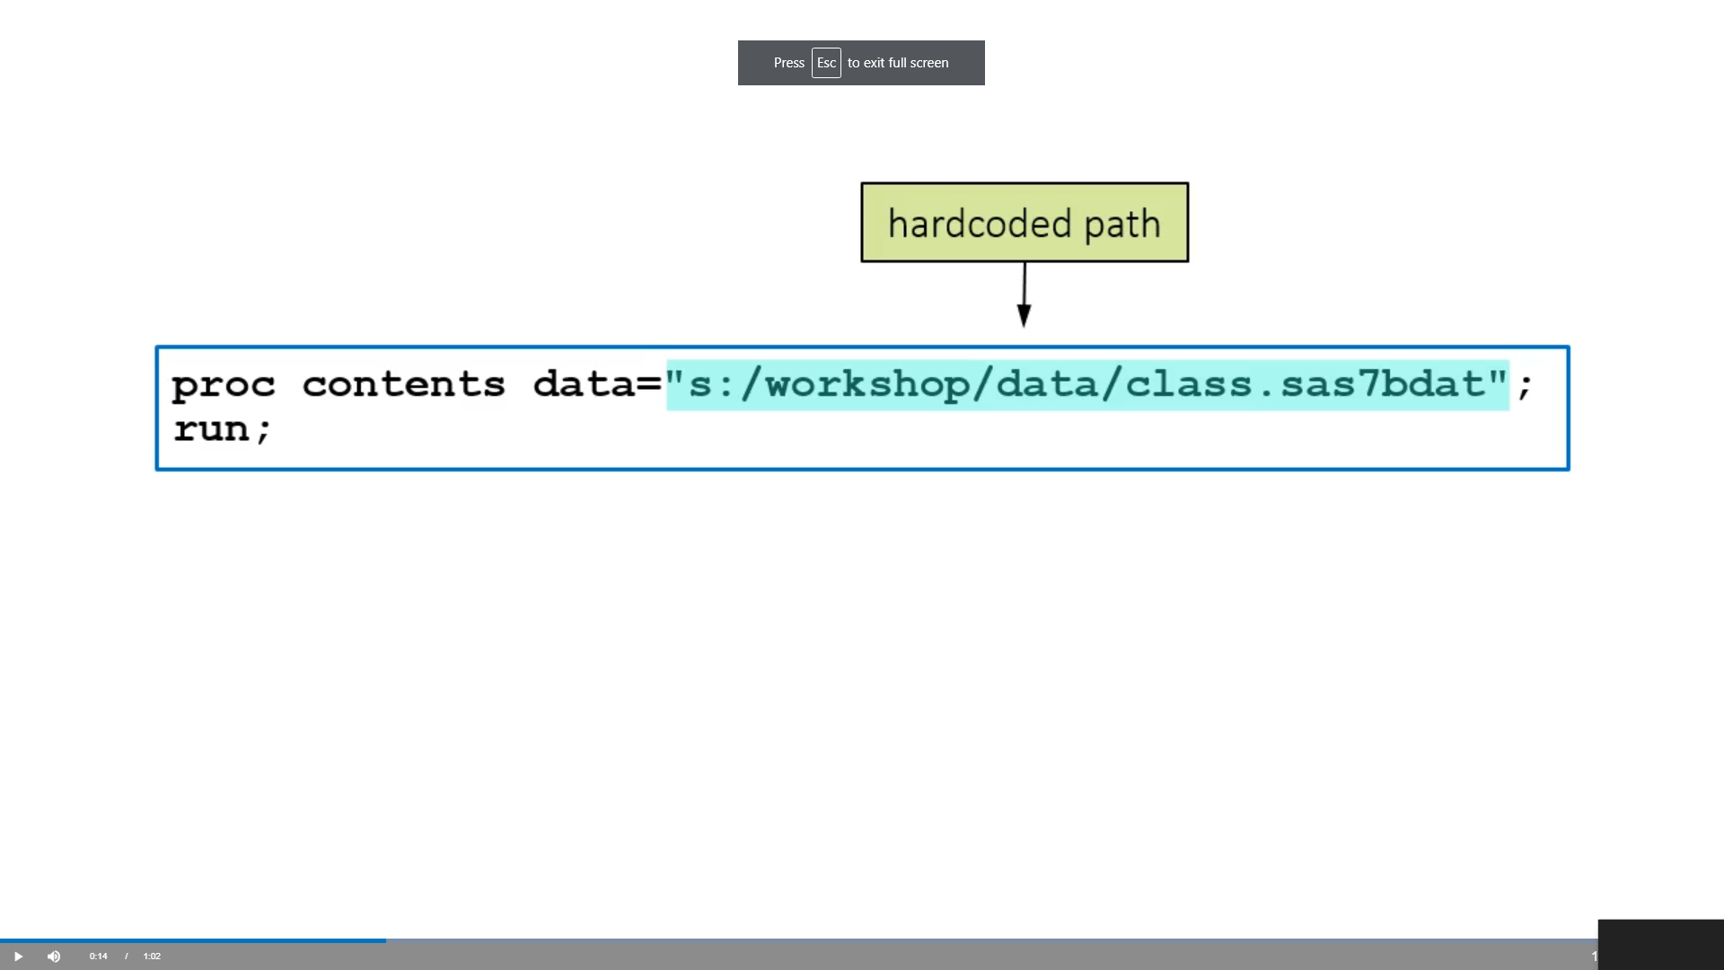

Slide 38
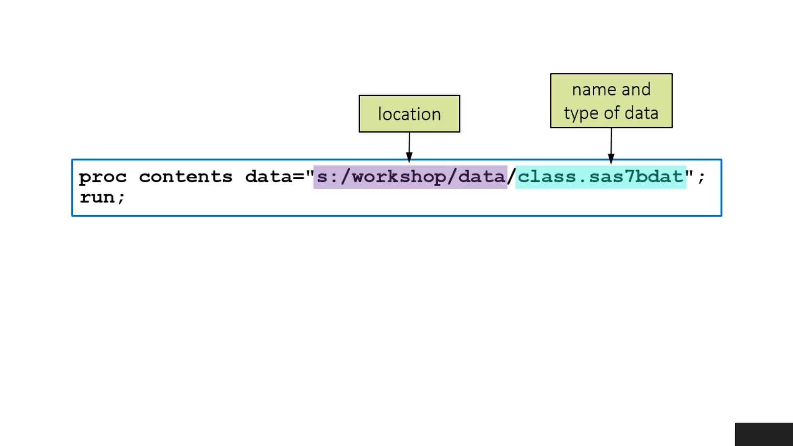

Slide 39
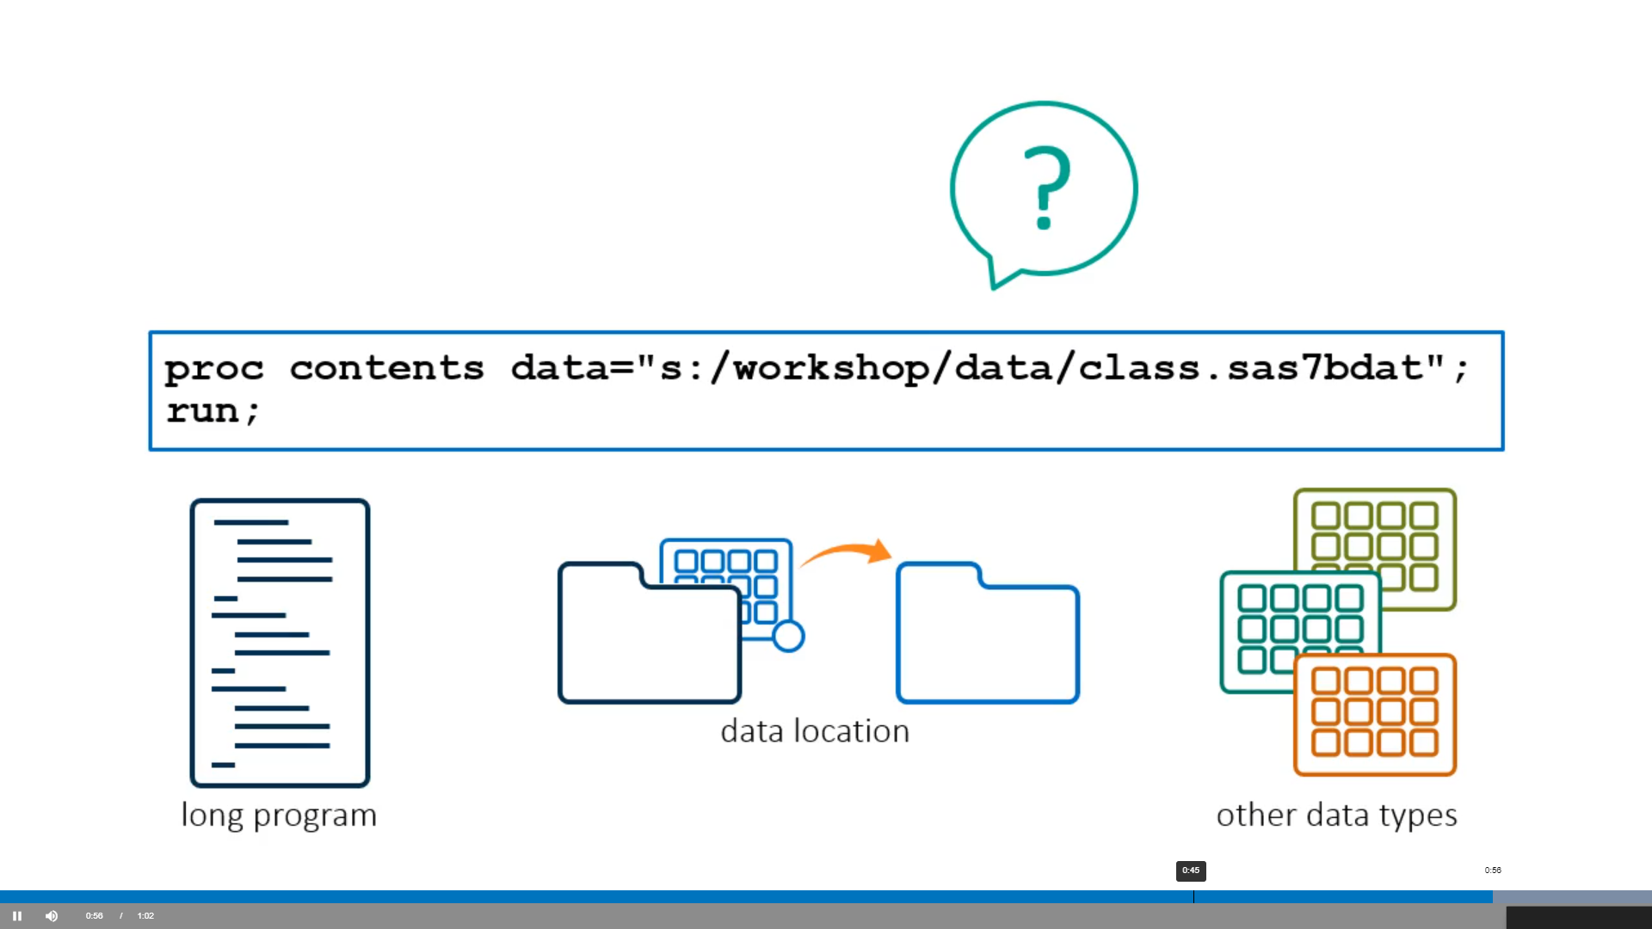

Slide 40
